Slide 1
Docker and Containers

Slide 2
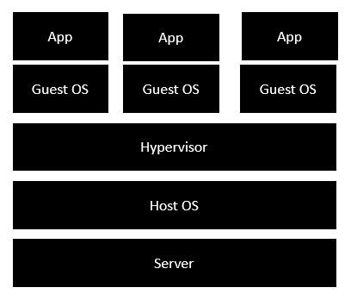
Traditional Virtualization
•Server is the physical server that is used to host multiple virtual machines.
•Host OS is the base machine such as Linux or Windows.
•Hypervisor is either VMWare or Windows Hyper V that is used to host virtual machines.
•One would then install multiple operating systems as virtual machines on top of the existing hypervisor as Guest OS.
•One would then host your applications on top of each Guest OS.

Slide 3
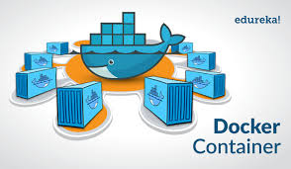
Dockers
Dockers containers are analogous to physical containers that you can use to store, package, and transport goods.
But instead of tangible goods, they’re containers for software applications.

Slide 4
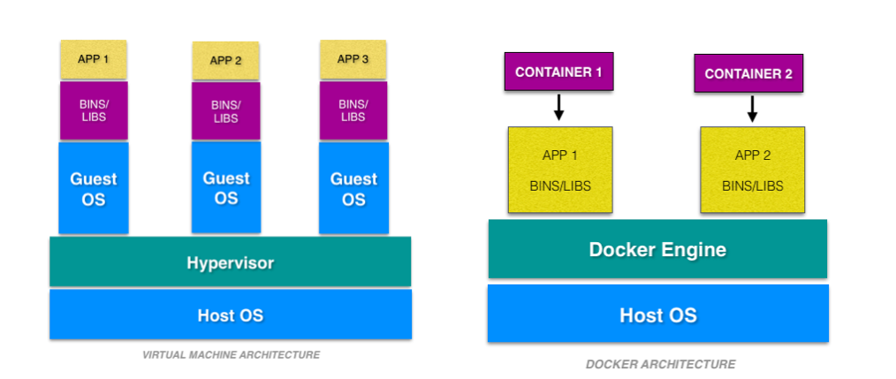
Dockers
A container is an environment that runs an application that is not dependent on the operating system.
A docker container is a portable unit of software—
that has the application
along with the all of its associated dependency and configuration.

Slide 5
What is a Container?
The kernel of the host operating system
serves the needs of running different functions of an app, separated into containers.

Slide 6
What is a Container?
Each container runs isolated tasks.
It cannot harm the host machine nor
come in conflict with other apps running in separate containers.

Slide 7
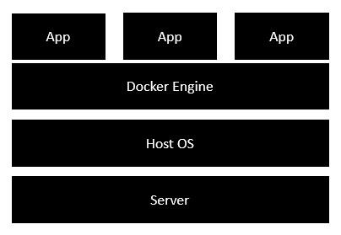
Docker – Architecture
•Docker engine-
is used to virtualize the guest operating system which earlier used to run in virtual machines
•All of the Apps now run as Docker containers.

Slide 8
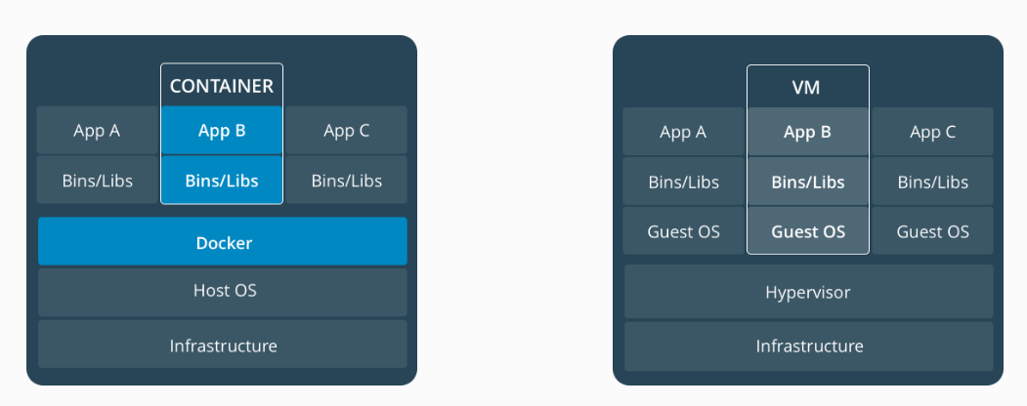
Containers vs Virtual Machines
Container
VM

Slide 10
Virtual Machines and Containers
Virtual machines run guest operating systems - the OS layer in each box.
Resulting disk image and application state is
an entanglement of OS settings,
system-installed dependencies,
OS security patches

Slide 11
Virtual Machines and Containers
•Containers can share a single kernel, and the only information that needs to be in a container image is the executable and its package dependencies, which never need to be installed on the host system.
•These processes run like native processes, and can be managed individually
•Because they contain all their dependencies, there is no configuration entanglement;
A containerized app “runs anywhere”

Slide 12
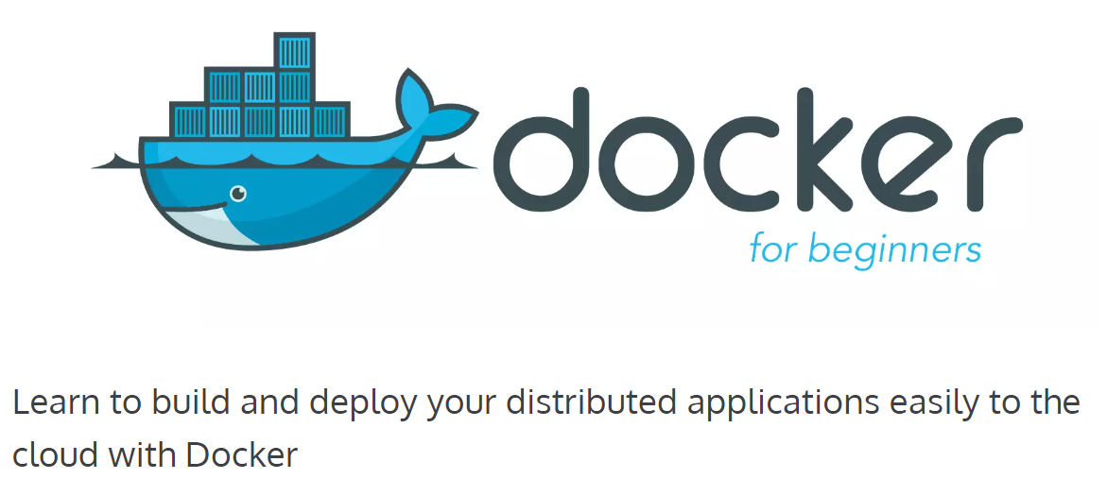

Slide 13
Dockers
An open-source project that automates the deployment of software applications inside containers by providing an additional layer of abstraction and automation of OS-level virtualization on Linux.
- Wikipedia

Slide 14
Dockers
Containers offer a logical packaging mechanism in which applications can be abstracted from the environment in which they actually run.
This decoupling allows container-based applications to be deployed easily and consistently, regardless of whether the target environment is a private data center, the public cloud, or even a developer’s personal laptop.
This gives developers the ability to create predictable environments that are isolated from the rest of the applications and can be run anywhere.

Slide 15
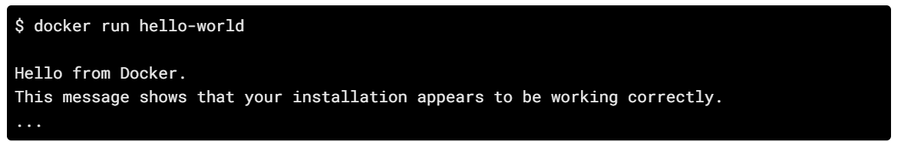
Docker commands
Set up Docker on Mac, Linux and Windows.
Once you are done installing Docker,
Test your Docker installation by running the following:

Slide 16

Docker commands
Lets run a Busybox container on our system and get a taste of the docker run command.
To get started, let's run the following in our terminal:
The pull command fetches the busybox image from the Docker registry and saves it to our system.

Slide 17
Docker commands
Note: Depending on how you've installed docker on your system, you might see a permission denied error after running the above command.
If you're on a Mac, make sure the Docker engine is running.
If you're on Linux, then prefix your docker commands with sudo.

Slide 18
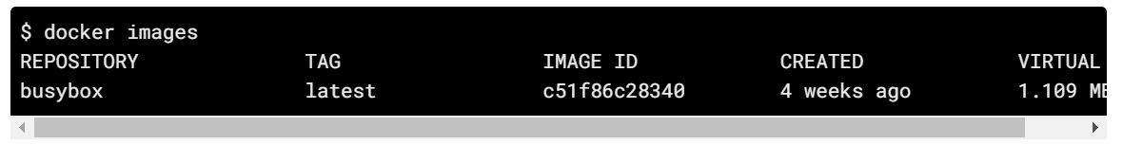
You can use the docker images command to see a list of all images on your system.

Slide 19
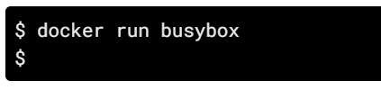
Docker Run
Great! Let's now run a Docker container based on this image. To do that we are going to use the almighty docker run command.
Wait, nothing happened! Is that a bug? Well, no. Behind the scenes, a lot of stuff happened.

Slide 20
Docker Run
When you call run, the Docker client finds the image (busybox in this case), loads up the container and then runs a command in that container.
When we executed docker run busybox, we didn't provide a command, so the container booted up, ran an empty command and then exited.

Slide 21

Docker Run
Nice - finally we see some output.
In this case, the Docker client dutifully ran the echo command in our busybox container and then exited it.
If you've noticed, all of that happened pretty quickly. Imagine booting up a virtual machine, running a command and then killing it. Now you know why they say containers are fast!

Slide 22
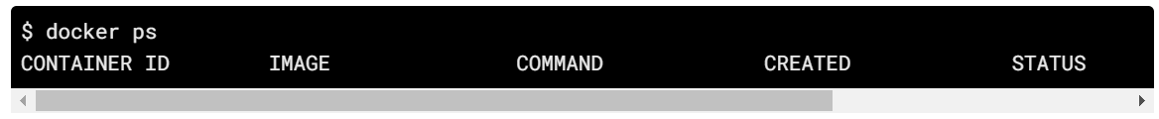
Docker ps
Ok, now it's time to see the docker ps command.
The docker ps command shows you all containers that are currently running.
Since no containers are running, we see a blank line.
A list of running containers can be seen using the docker ps command.

Slide 23
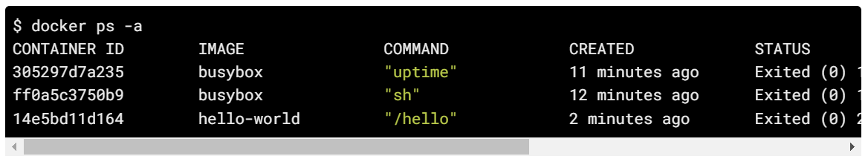
Docker ps
Let's try a more useful variant:
docker ps –a
So what we see above is a list of all containers that we ran.
Do notice that the STATUS column shows that these containers exited a few minutes ago.

Slide 24
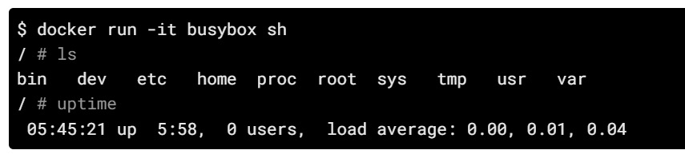
Docker Run
You're probably wondering if there is a way to run more than just one command in a container. Let's try that now:
Running the run command with the -it flags attaches us to an interactive tty in the container.
Now we can run as many commands in the container as we want.

Slide 25
Docker Run
let's quickly talk about deleting containers.
We saw above that we can still see remnants of the container even after we've exited by running docker ps -a.
You'll run docker run multiple times and leaving stray containers will eat up disk space.
Hence, as a rule of thumb, I clean up containers once I'm done with them.

Slide 26
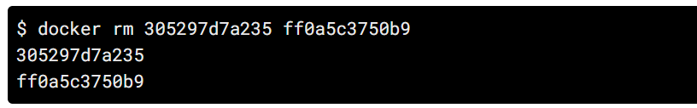
Docker rm
To do that, you can run the docker rm command. Just copy the container IDs from above and paste them alongside the command.

Slide 27

Docker rm
On deletion, you should see the IDs echoed back to you.
If you have a bunch of containers to delete in one go, copy-pasting IDs can be tedious.
In that case, you can simply run -
This command deletes all containers that have a status of exited.
the -q flag, only returns the numeric IDs and
-f filters output based on conditions provided.

Slide 28
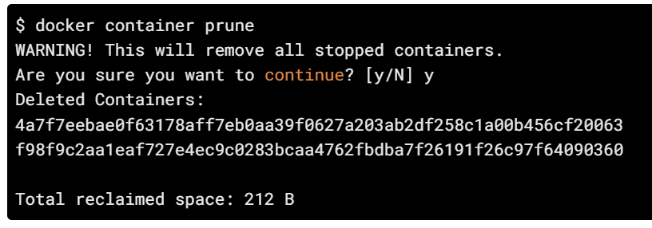
Docker prune
In later versions of Docker, the docker container prune command can be used to achieve the same effect.

Slide 29
Docker Terminology
Images - The blueprints of our application which form the basis of containers. In the demo above, we used the docker pull command to download the busybox image.
Containers - Created from Docker images and run the actual application. We create a container using docker run which we did using the busybox image that we downloaded.
A list of running containers can be seen using the docker ps command.

Slide 30
Docker Terminology
Docker Daemon - The background service running on the host that manages building, running and distributing Docker containers. The daemon is the process that runs in the operating system which clients talk to.
Docker Client - The command line tool that allows the user to interact with the daemon. More generally, there can be other forms of clients too - such as Kitematic which provide a GUI to the users.

Slide 31
Docker Terminology
Docker Hub - A registry of Docker images. You can think of the registry as a directory of all available Docker images. If required, one can host their own Docker registries and can use them for pulling images.

